Slide 2
Fertilization

Slide 3
It occurs when man and woman mate in a process known as coitus or sexual intercourse where male inserts penis into the vagina
Fertilization takes place in the oviduct (fallopian tube)
Fertilization is the fusion of the sperm and the ovum
After fertilization a zygote is formed and moves from fallopian tube and is implanted in the uterus
After implantation, zygote attaches to the uterus walls where it changes to embryo
After about 6 months it develops into foetus
Foetus is connected to the placenta by umbilical cord

Slide 4
Summary of foetal development
zygote
Embryo
Foetus
Full grown baby

Slide 5
Functions of the placenta
Supplies the embryo with food from the mother’s blood
Exchange of oxygen and carbon dioxide takes place
Waste matter from the embryo also passes through the placenta to the mother’s blood system

Slide 6
Functions of the umbilical cord
Connects embryo to the placenta
Has an artery and vein
Food substances and oxygen pas to the embryo through the artery while waste products such as the carbon dioxide pass from the embryo through the vein into the placenta

Slide 7
Amniotic fluid
Within the uterus the embryo is held in a bag like structure called amnion sac which contains a liquid called amniotic fluid in which the embryo floats
The fluid protects the embryo from shock and physical damage
Also protects the embryo from dehydration
Reduces friction
Allows an easy movement of the foetus
Acts as a lubricant during the birth process

Slide 8
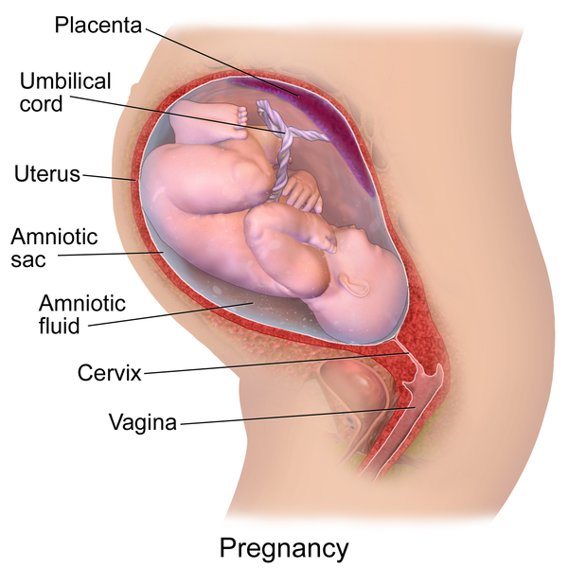
Pregnancy

Slide 9
Note
Mother’s blood and that of the embryo do not come into contact
Exchange of material takes place in the placenta
The gestation period in human beings is nine months
Gestation is the period taken for a zygote to develop to a full grown baby

Slide 10
Signs of pregnancy
The menstrual period stops
Breasts become large, tender and sensitive
Morning sickness may occur where women feel nausea
Enlargement of the abdomen
Foetal development

Slide 11
The birth process
Contraction of the uterine wall
Labour pains start
Cervix relaxes or dilates (opens)
Breaking of the amniotic sac
Pushing out of the baby
Coming out of the baby
Umbilical cord is tied and then cut (to separate the baby from the placenta)
Umbilical cord and the placenta break away from the uterus
Expulsion of the afterbirth (placenta)

